Slide 1
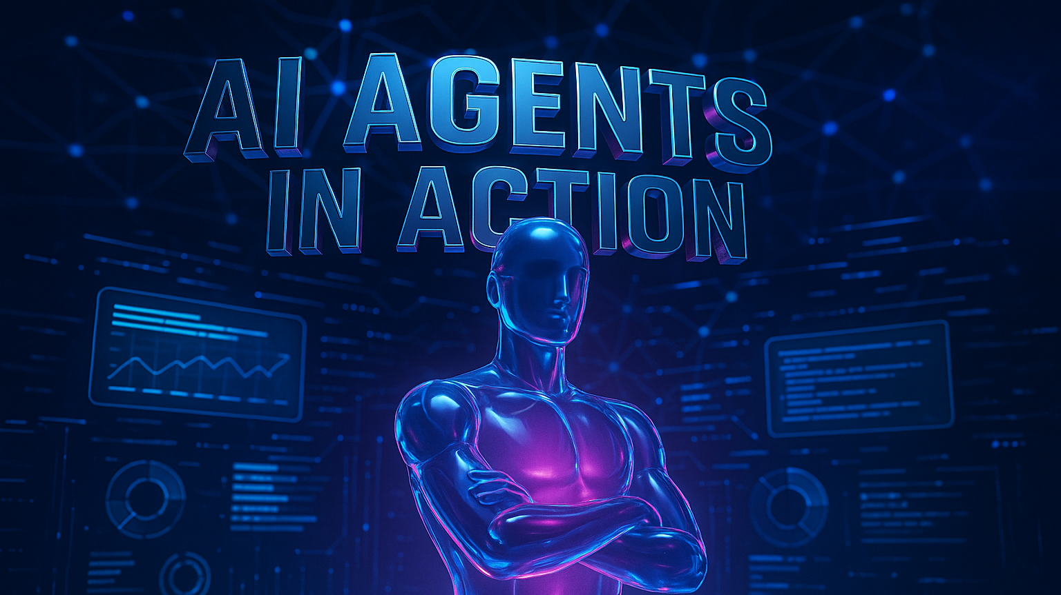
AI Agents in Action
The Rise of Autonomous AI (presentation and images created with AI Agents powered by Claude Sonnet 4.0, GPT4o and gpt-image-1 Sora)
Notes:
Visual: Hero graphic of a stylized agent silhouette backed by brand colours (primary blue + gradient purple-pink).

Slide 2
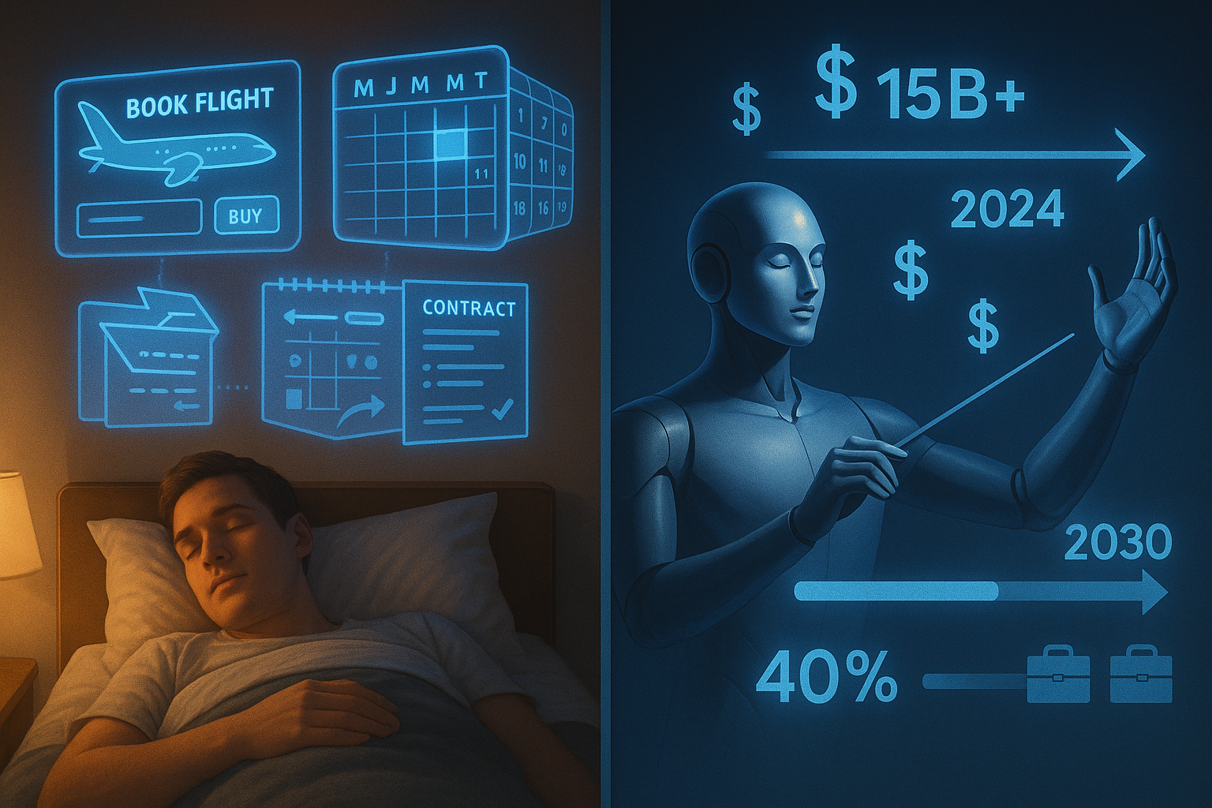
Why Agents Matter Now
The Evolution: From reactive to proactive AI
Market Reality: $15B+ investment in agent technology in 2024
Your Future: Agents will handle 40% of knowledge work by 2030
Notes:
Visual: Timeline showing AI evolution from chatbots to agents.

Slide 3
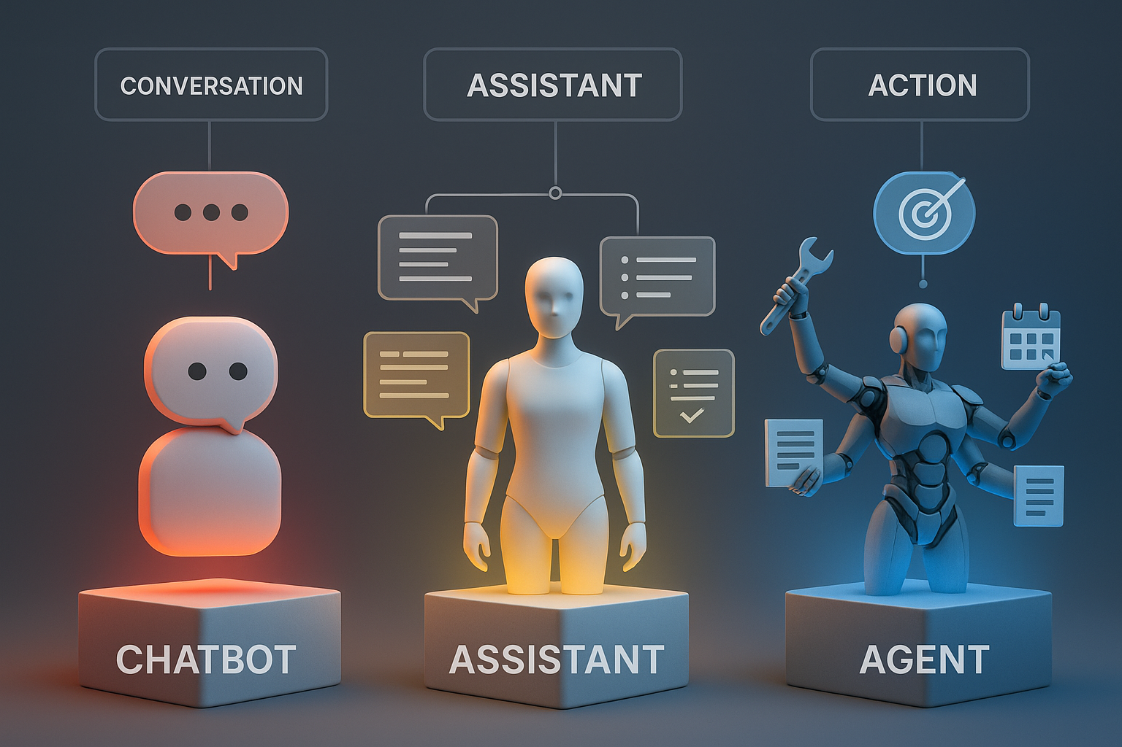
Agents vs Assistants vs Chatbots
Chatbot: Single-turn Q&A, no memory (e.g., basic customer service bot)
Assistant: Multi-turn help, limited goals (e.g., Siri, Alexa)
Agent: Autonomous, goal-driven, tool‑using (e.g., AutoGPT, Claude with tools)
Notes:
Speaker note: Emphasize autonomy and environment interaction—"agents act, others react." | Visual: Three‑column comparison with real-world examples.

Slide 4
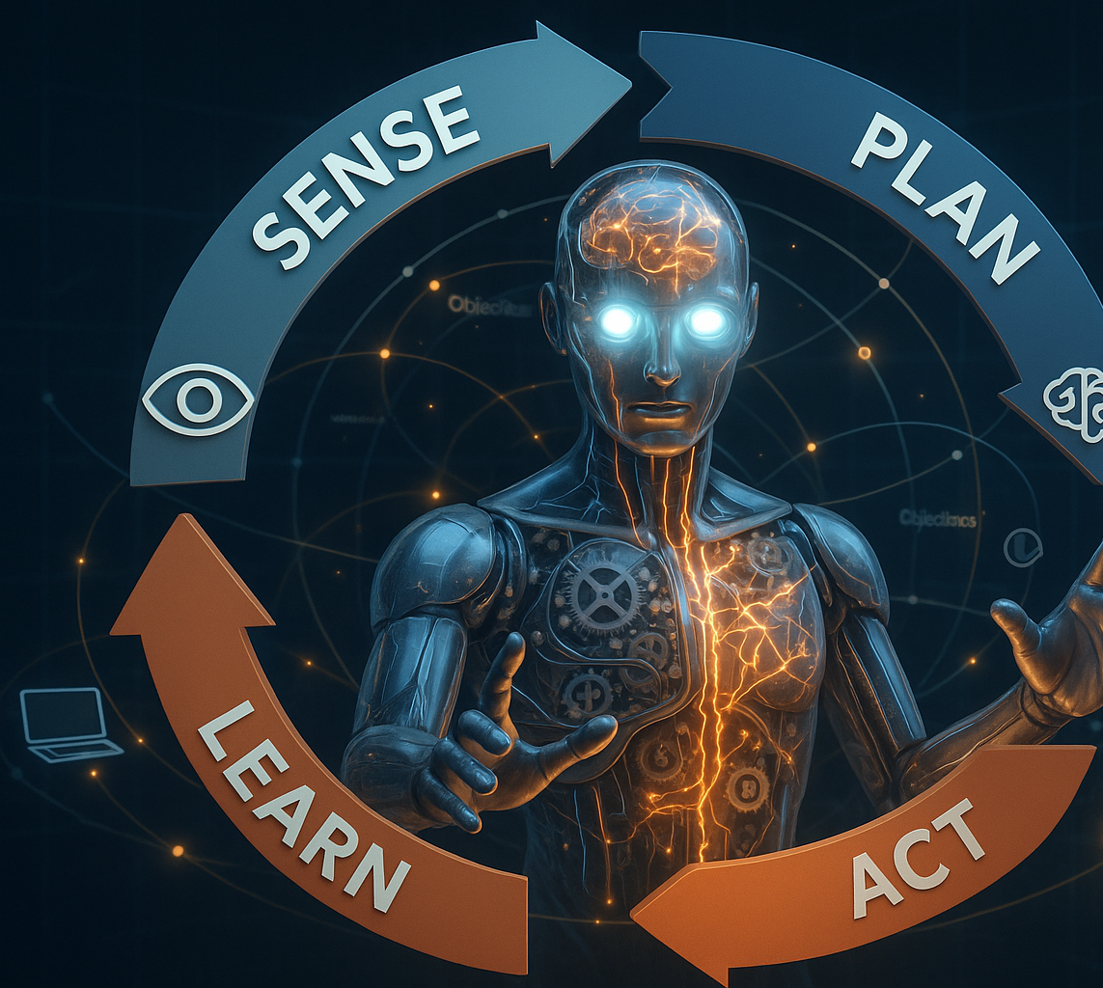
What Makes an Agent—True Agency
Defined objective & self-directed actions
Internal feedback loop (sense–plan–act–learn)
Observable impact on the outside world
Persistence across sessions and tasks
Notes:
Visual: Sense–plan–act–learn loop diagram (Figure 1.3).

Slide 5
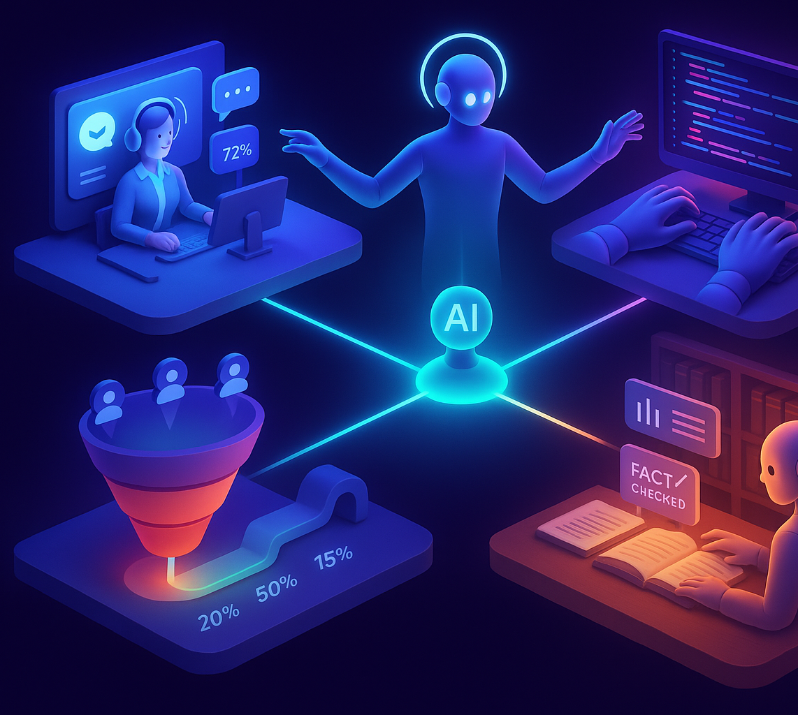
Agents in the Wild
Customer Service: Intercom's Resolution Bot (resolves 70% of inquiries)
Software Development: GitHub Copilot Workspace (end‑to‑end coding)
Sales: Outreach.ai sequences (automated lead nurturing)
Deep research and research agents
Brilliant Harvest – AgTech
Notes:
Visual: Screenshot montage of each example.

Slide 6
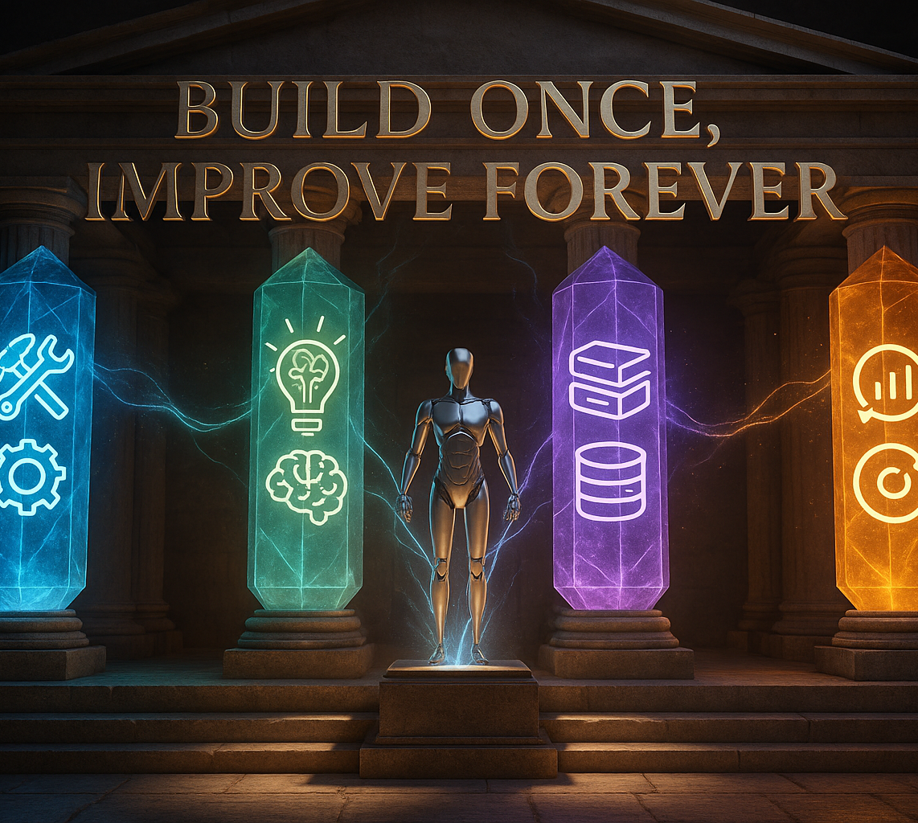
The Four Pillars Framework
Actions & Tools (🔧)
Reasoning & Planning (🧠)
Memory & Knowledge (📚)
Evaluation & Feedback (📊)
Notes:
Tagline: "Build once, improve forever" | Visual: Four-column pillars graphic.

Slide 7
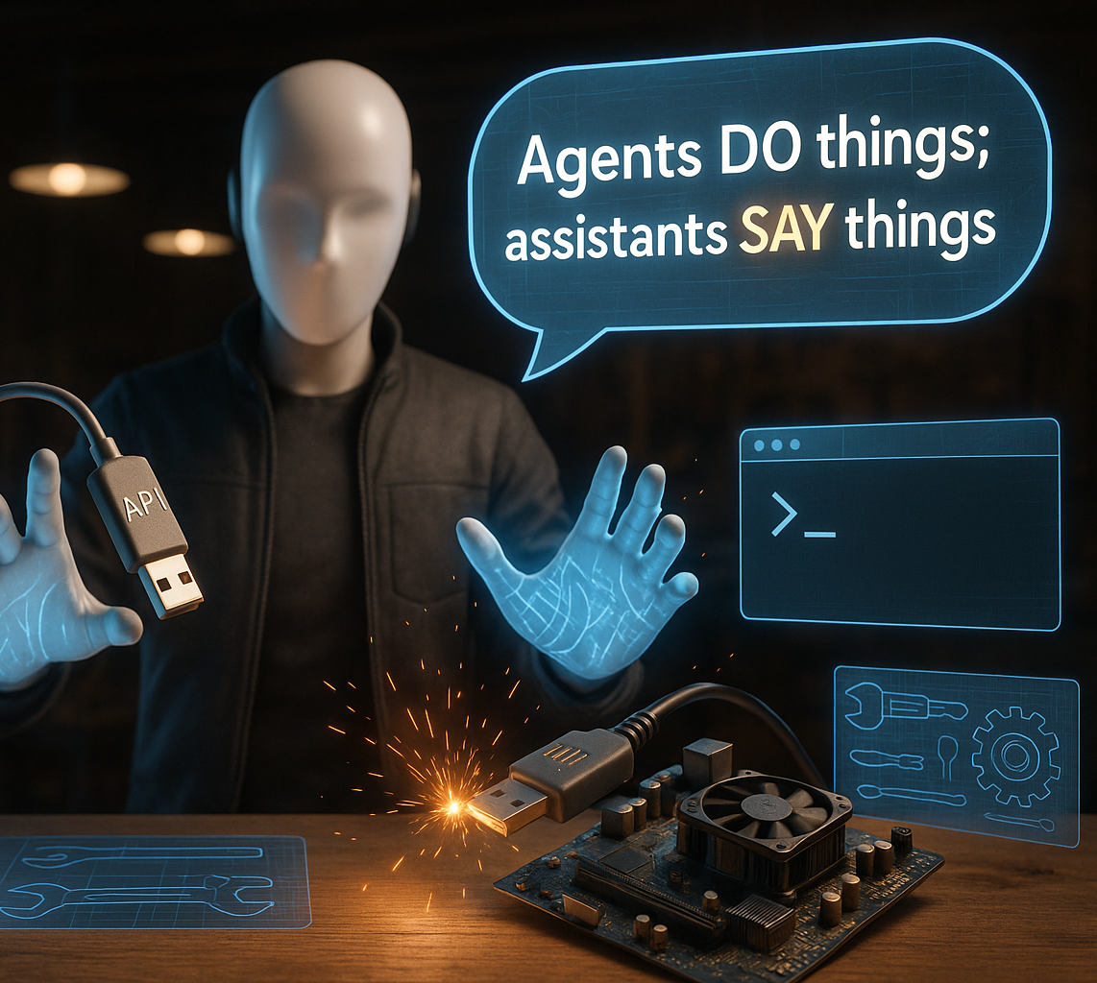
Pillar 1 – Actions & Tools
External APIs, OS calls, hardware control
Tool schema: name, arguments, description
Sandbox vs production permissions
Key Quote: "Agents do things; assistants say things."
Notes:
Visual: Code snippet showing tool call + demo GIF of agent controlling browser.

Slide 8
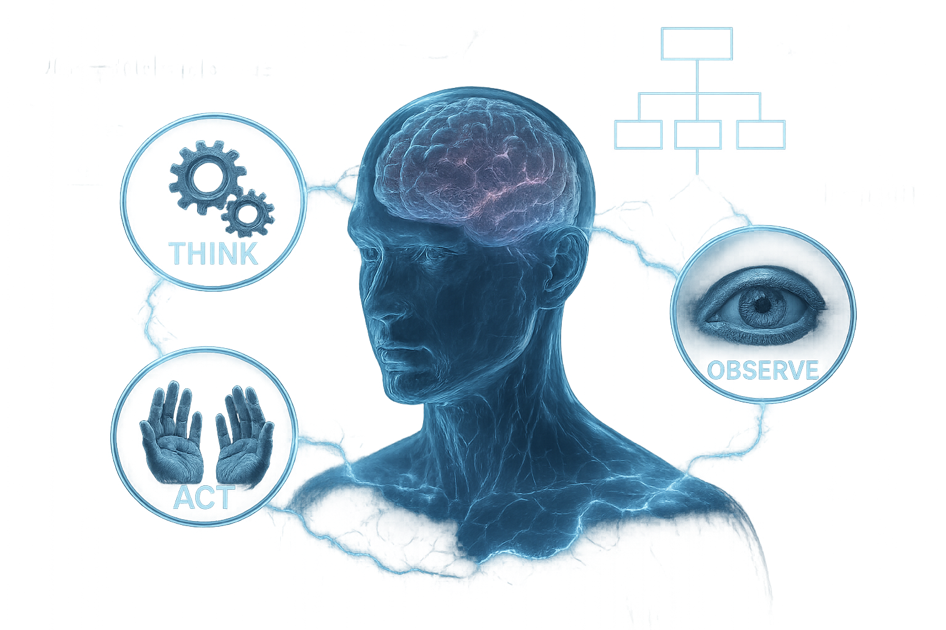
Pillar 2 – Reasoning & Planning
Chain‑of‑Thought → ReAct → Full planners
Hierarchical vs reactive approaches
Goal decomposition and multi-step execution
Notes:
Visual: ReAct loop diagram showing thought → action → observation cycle.

Slide 9
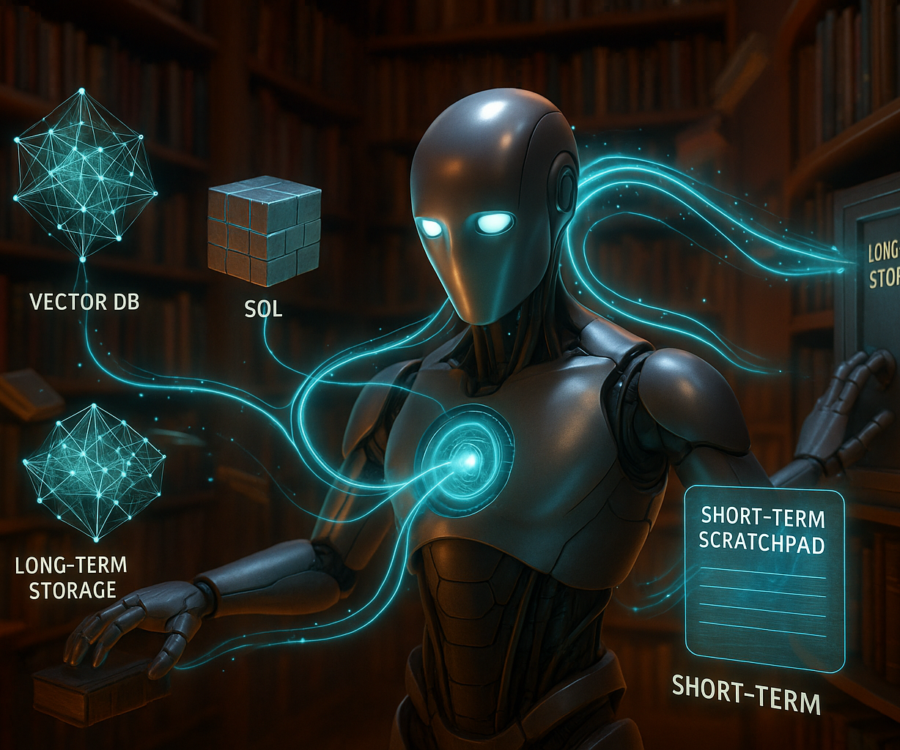
Pillar 3 – Memory & Knowledge
Long‑term store (vector DB, SQL, graph databases)
Short‑term scratchpad & episodic memory
Retrieval‑Augmented Generation (RAG) for dynamic knowledge
Hybrid, hybrid, hybrid
Notes:
Visual: RAG architecture diagram with data flow arrows.

Slide 10
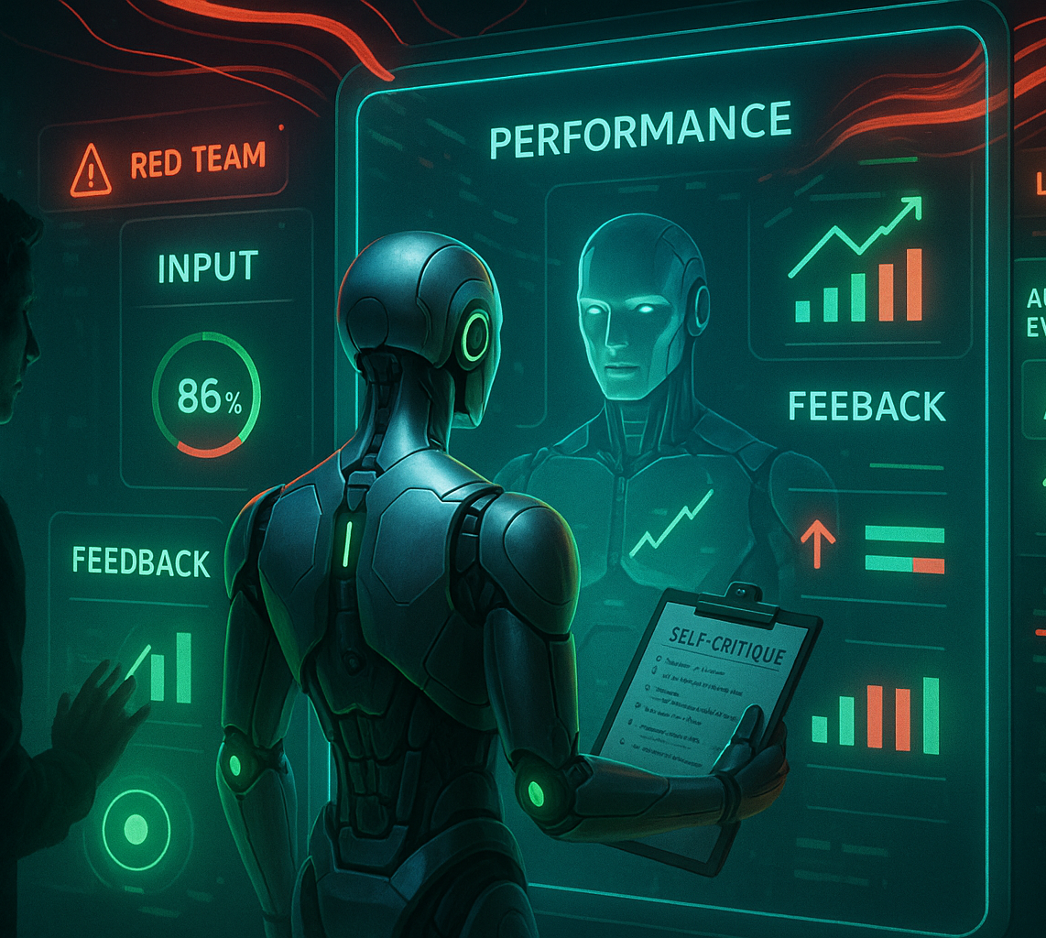
Pillar 4 – Evaluation & Feedback
Self‑critique and reward models
Human‑in‑the‑loop feedback systems
Logging, metrics, and red‑teaming hooks
A/B‑style evaluation cycles
Notes:
Visual: Feedback loop diagram with human and automated evaluation paths.

Slide 11
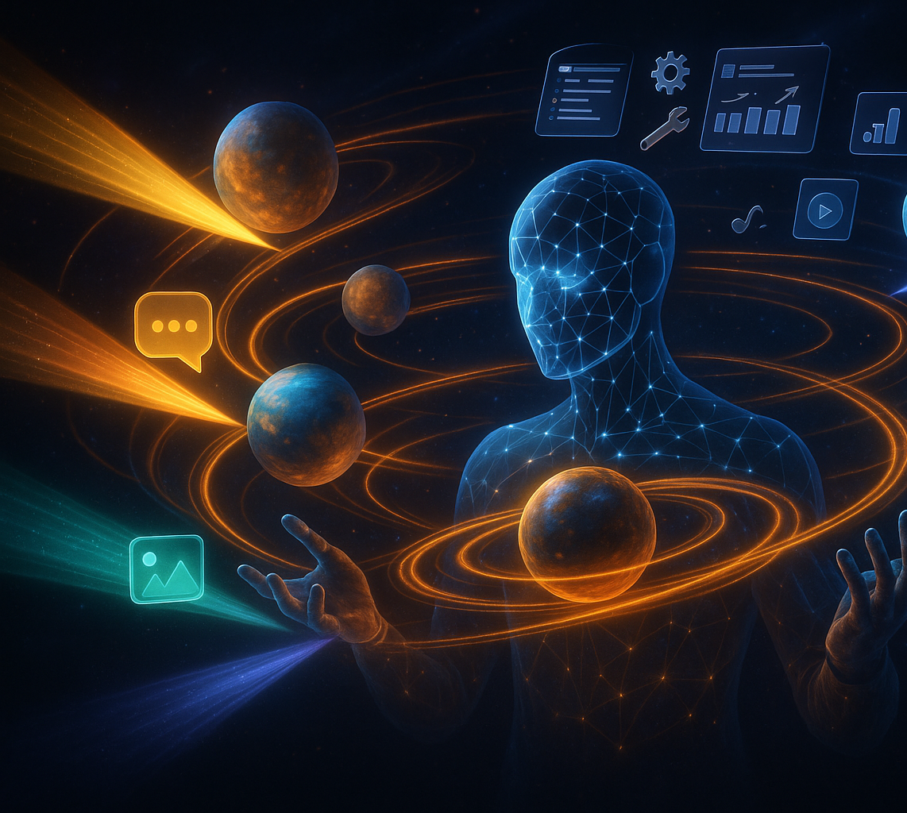
The Complete Agent Loop
Input → Memory retrieval → Reasoning → Action → Evaluation → Loop
Continuous learning from experience
Multi‑modal input/output streams
Tool orchestration and error handling
Notes:
Full workflow diagram integrating the four pillars.

Slide 12
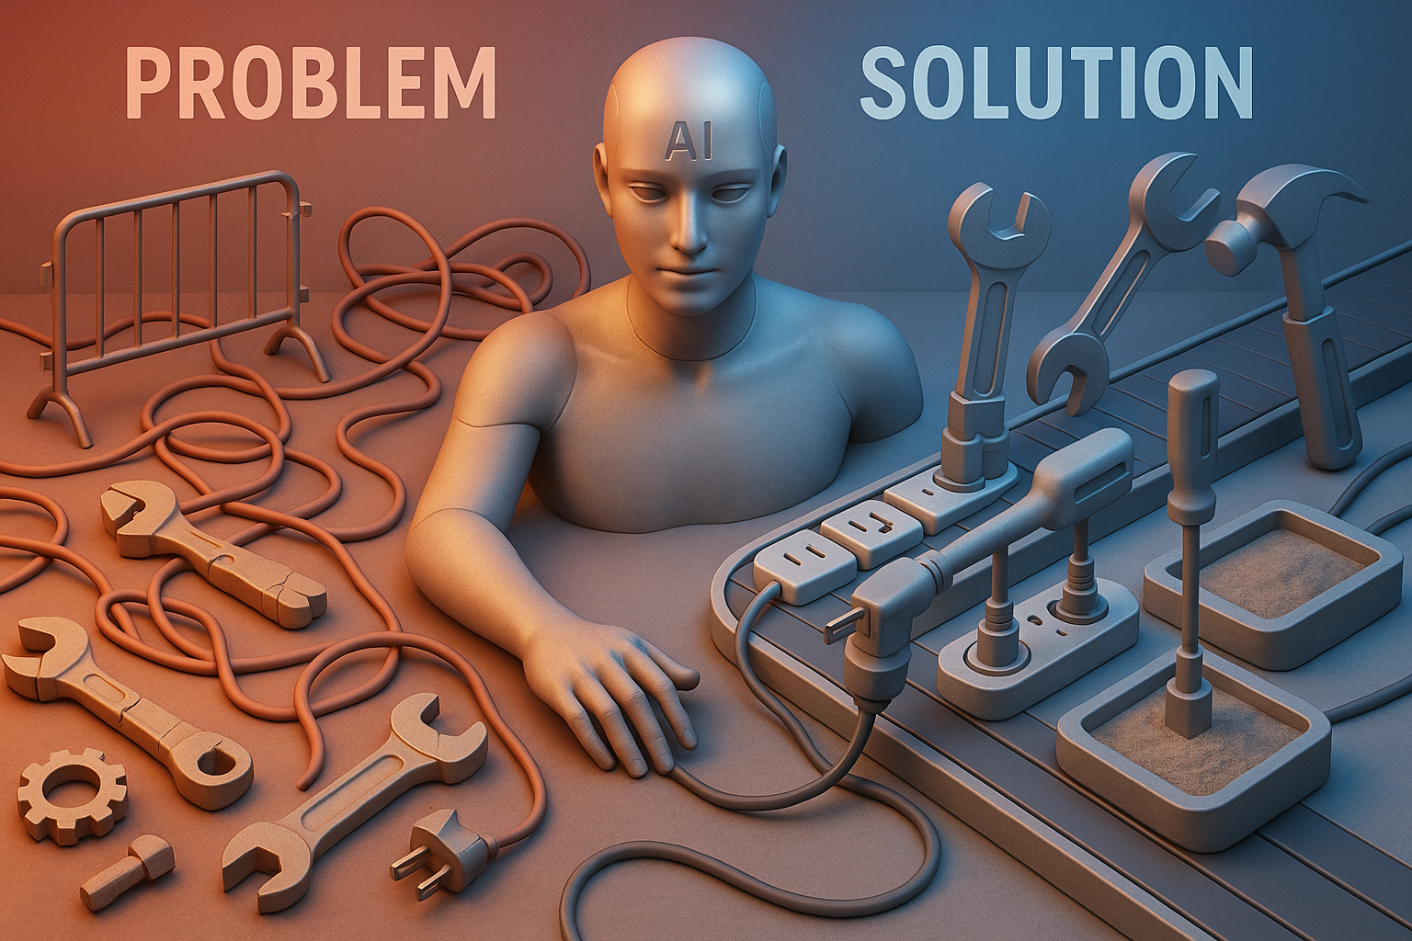
Integration Challenges & Solutions
Problems: Tool fragmentation, context switching overhead, permission & security complexity
Solutions: Universal protocols (MCP, OpenAI Functions, A2A), standardized interfaces & schemas, sandboxing & permissions

Slide 13
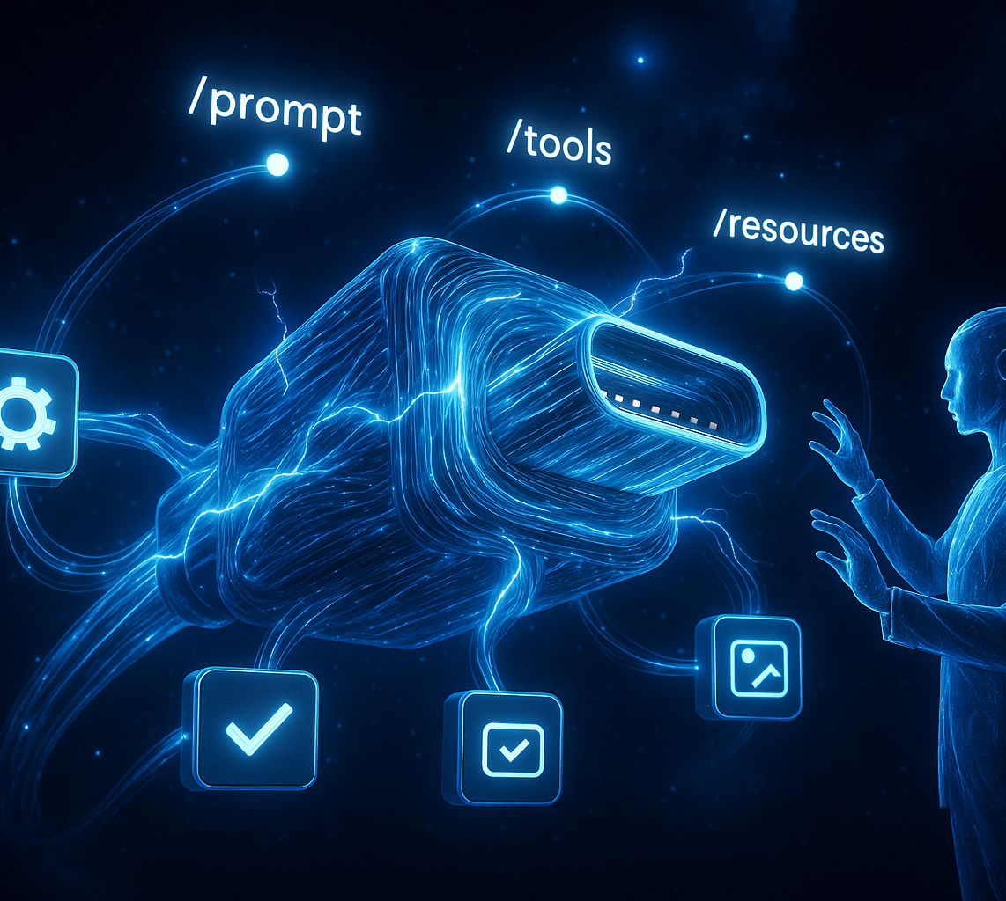
MCP: Universal Tool Integration
Model Context Protocol = "USB‑C for Agents"
Goal: Universal tool handshake
Key Features: Streaming I/O, capability negotiation
Endpoints: /prompt, /tools, /resources
Notes:
Visual: Conceptual stack diagram showing MCP as the bridge layer.

Slide 14
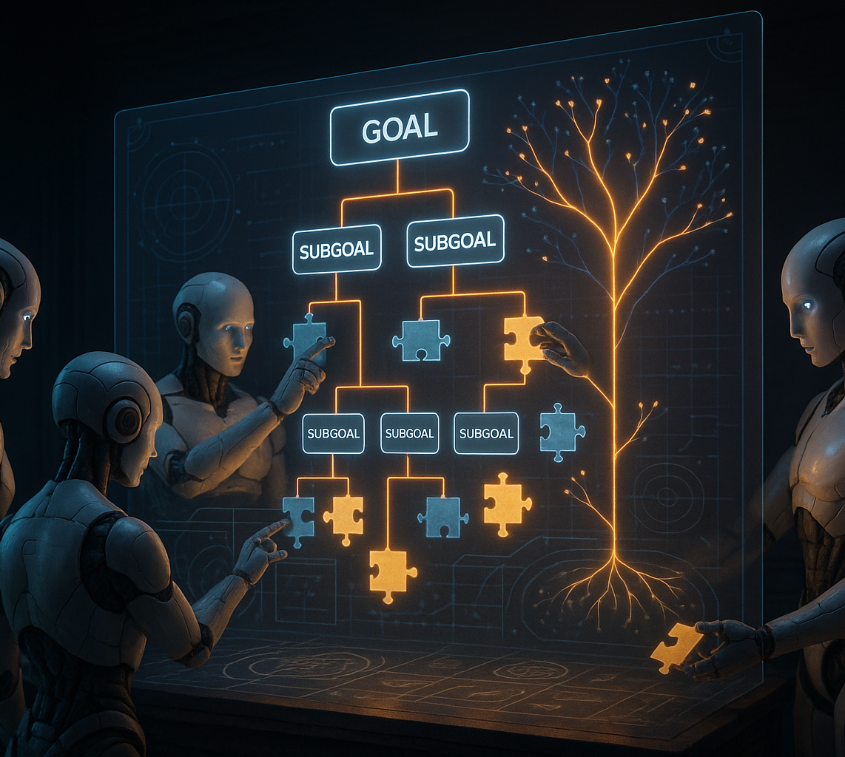
Advanced Planning Strategies
Multi‑agent coordination and task delegation
Hierarchical planning with sub‑goals
Dynamic replanning based on outcomes
Behavior trees vs LLM‑based heuristics
Notes:
Visual: YAML behavior tree snippet + planning hierarchy diagram.

Slide 15
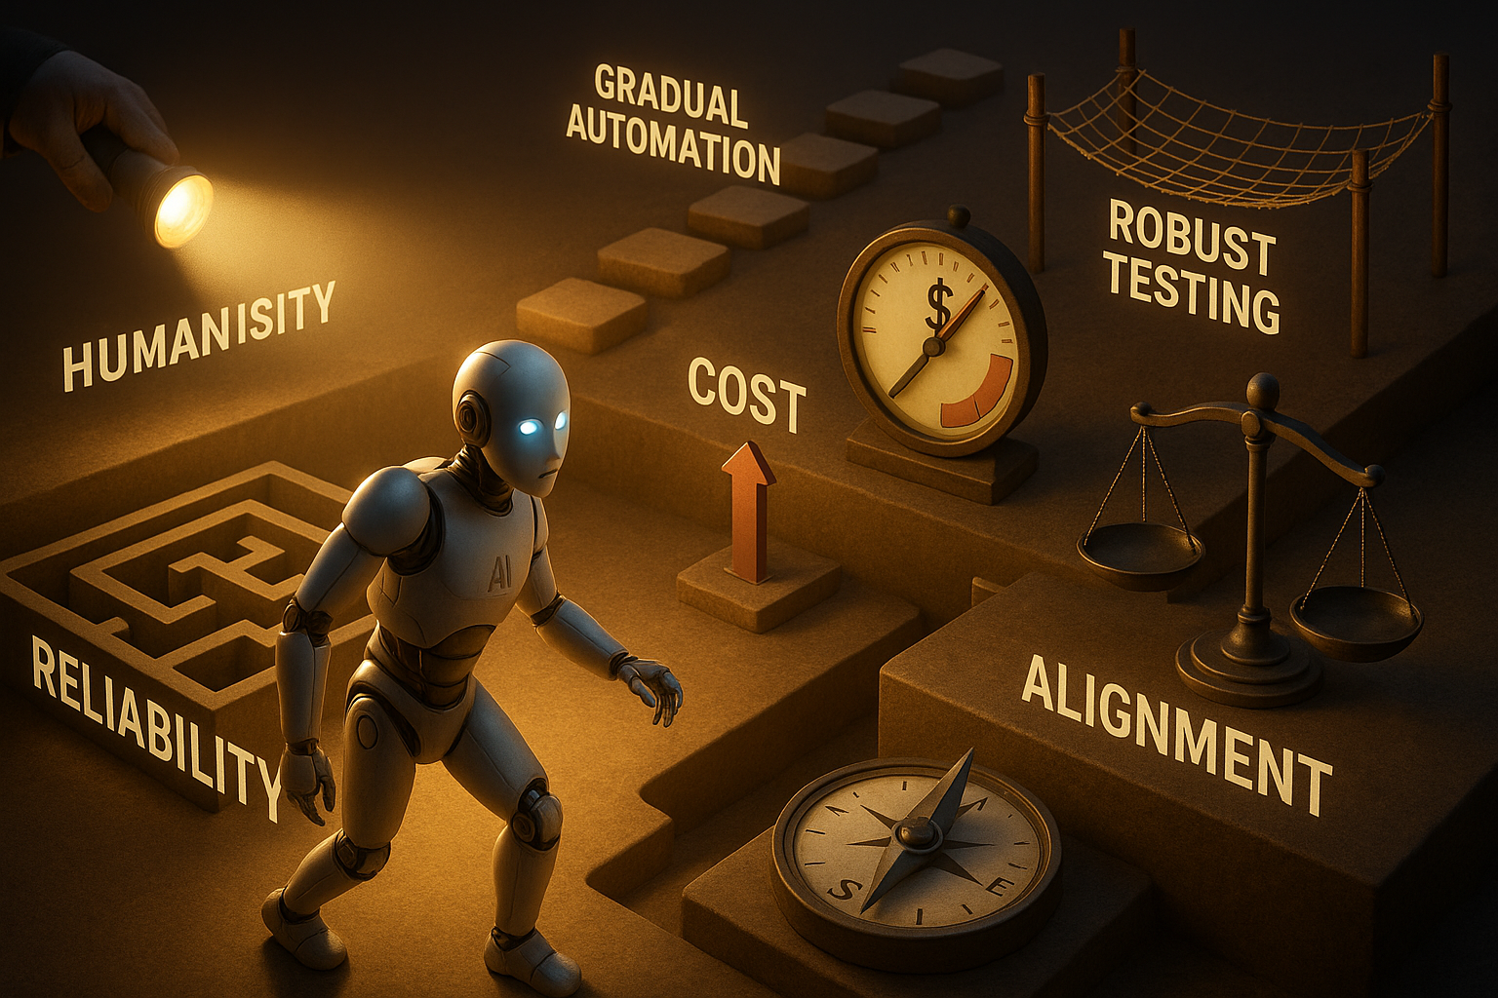
Challenges and Limitations
Reliability: Agents can fail in unexpected ways
Cost: Multiple LLM calls add up quickly
Trust: Verifying autonomous actions
Alignment: Ensuring agents do what you actually want
Mitigation: Human oversight, gradual automation, robust testing

Slide 16
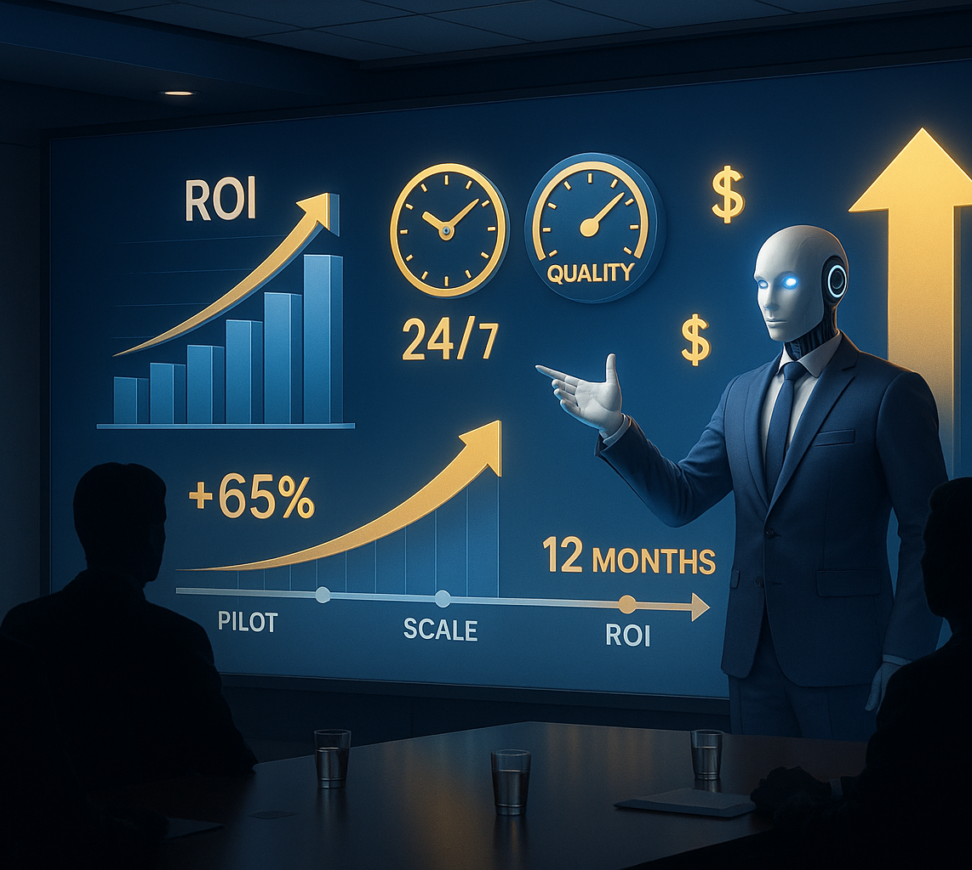
The Business Case for Agents
24/7 availability without human oversight
Consistent quality and reduced errors
Scalability beyond human capacity
Cost reduction for repetitive tasks
Investment Timeline: Pilot (3 mo) → Scale (6 mo) → ROI (12 mo)

Slide 17
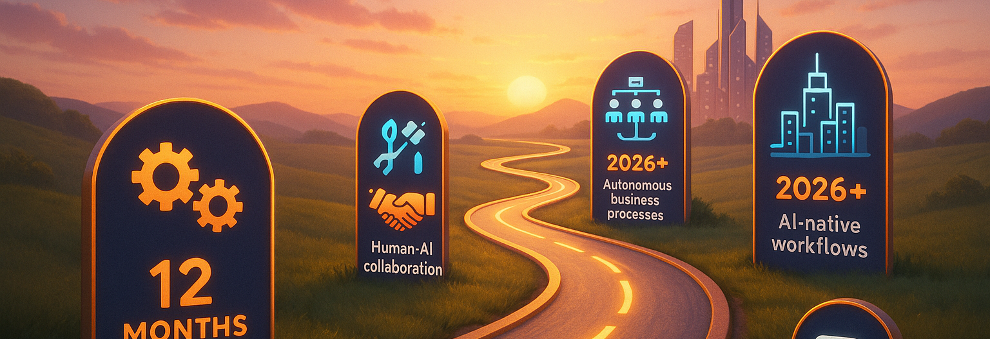
Future Roadmap
Next 12 Months: More reliable reasoning & planning, better tool standards, improved human‑AI collaboration
2026 and Beyond: Multi‑agent organizations, autonomous business processes, AI‑native workflows

Slide 18
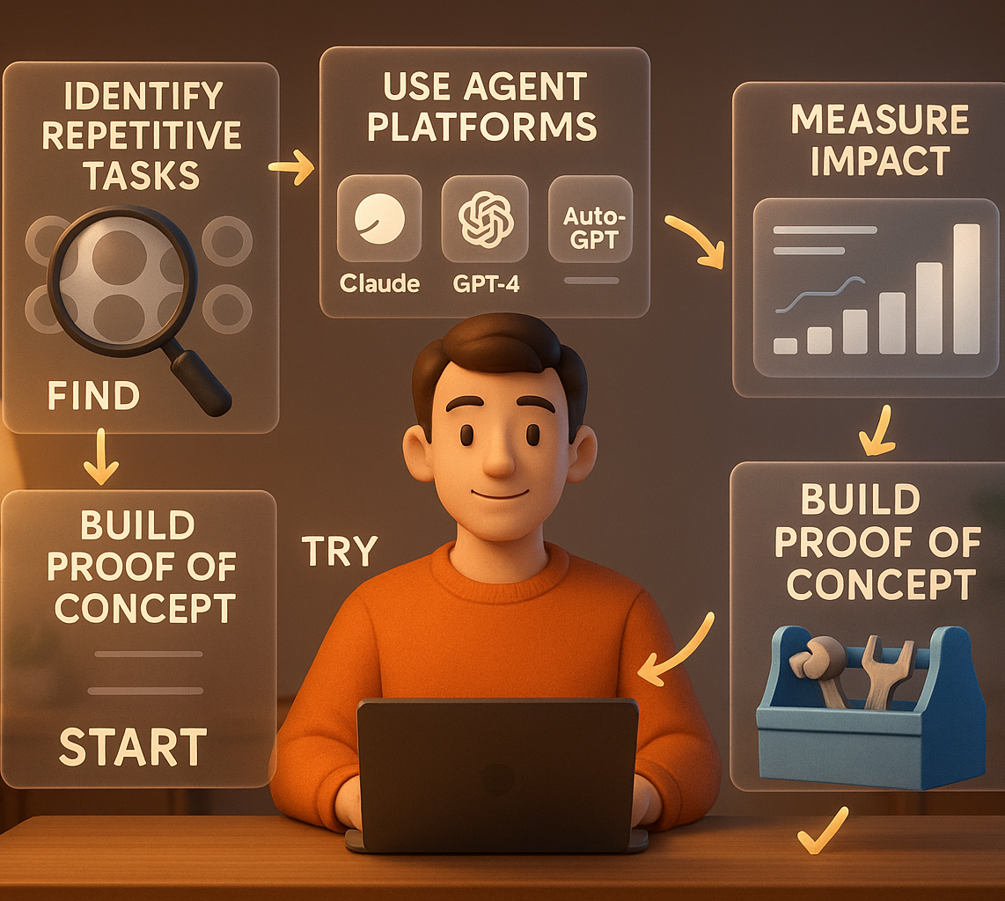
Getting Started Today
Identify one repetitive process in your workflow
Experiment with existing agent platforms (OpenAI Agents SDK)
Build a simple proof‑of‑concept
Measure the impact and iterate

Slide 19
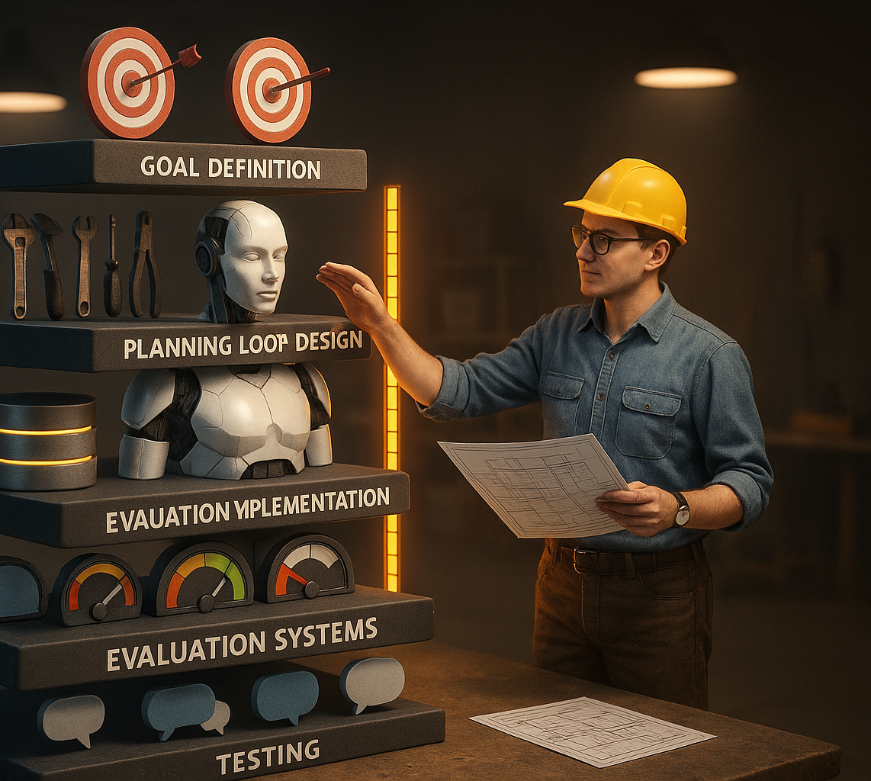
Building Your First Agent
Define the goal and success metrics
Identify required tools and permissions
Design the planning loop and decision points
Implement memory persistence and retrieval
Add evaluation and feedback mechanisms
Test and iterate with real scenarios
Notes:
Call to Action: "Start building your first agent today!" | Visual: Development flowchart.

Slide 20
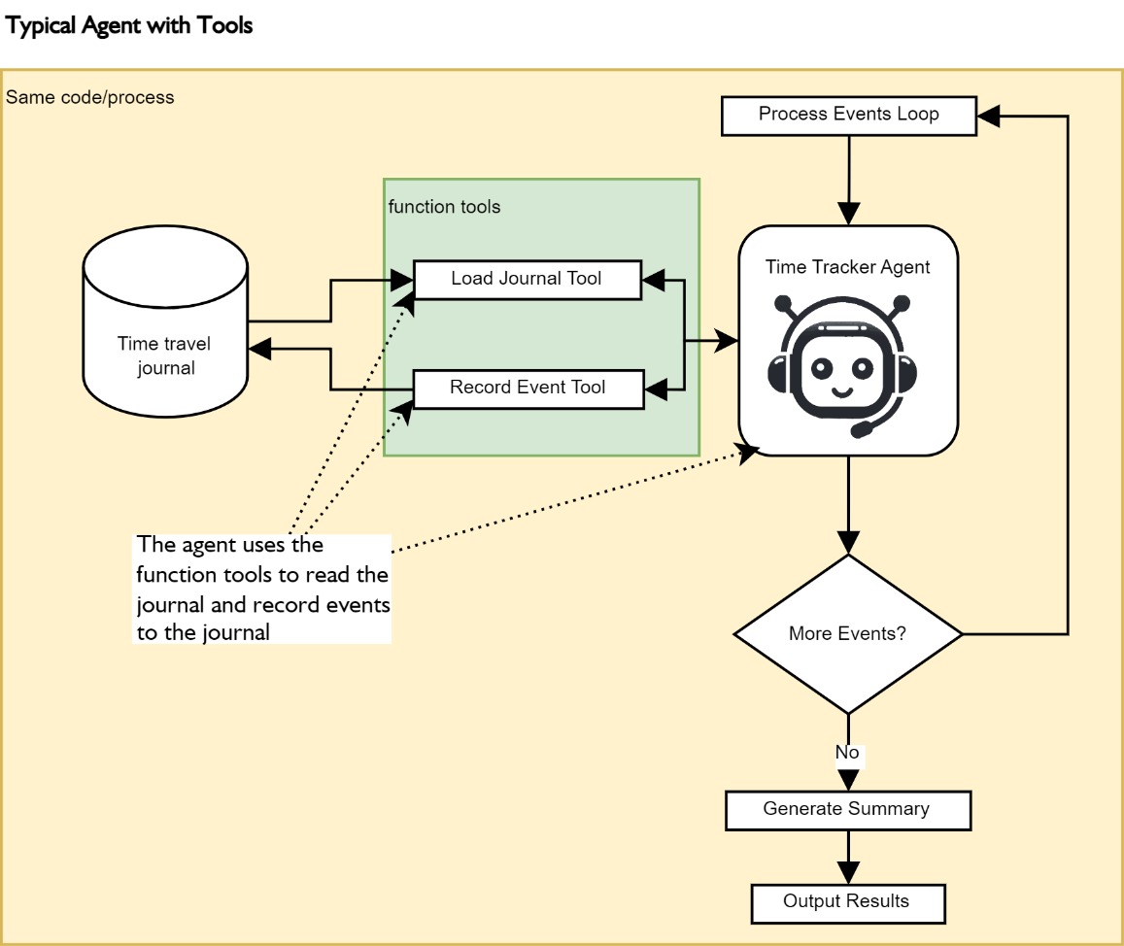
Demo Project (Time Tracker Agent)

Slide 21
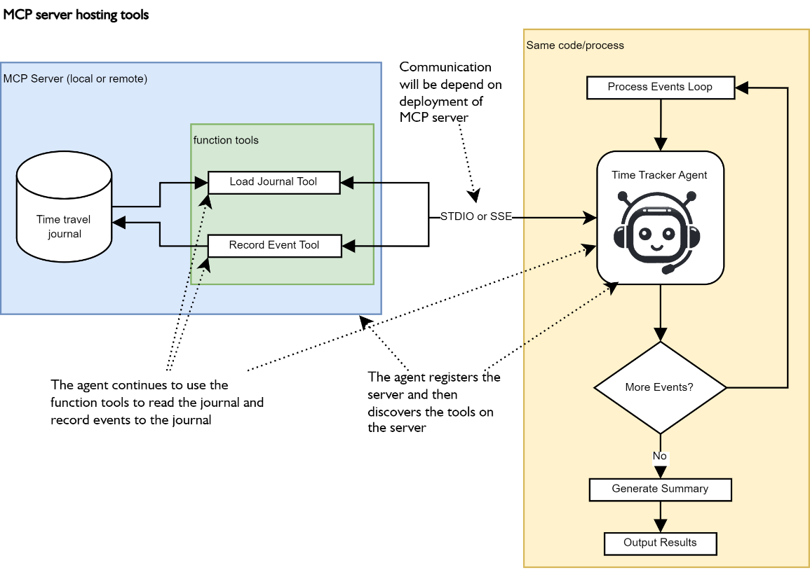
MCP Conversion

